Slide 1
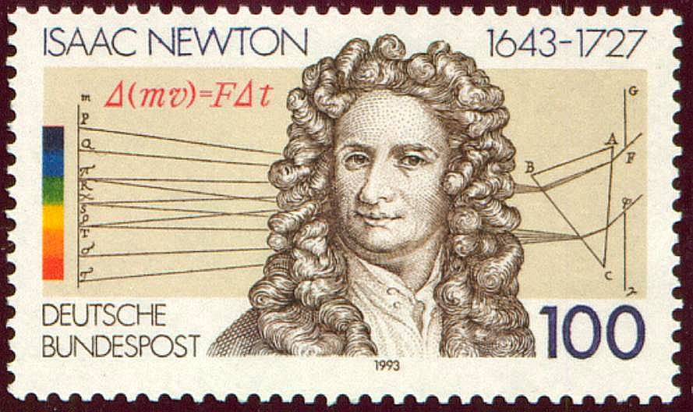
4.1, 4.3, 4.5: Linearization, MVT, L’Hopital’s
Greg Kelly, Hanford High School, Richland, Washington

Slide 2

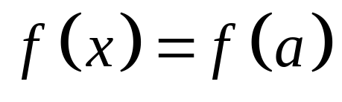




For any function f (x), the tangent is a close approximation of the function for some small distance from the tangent point.
We call the equation of the tangent the linearization of the function.

Slide 3
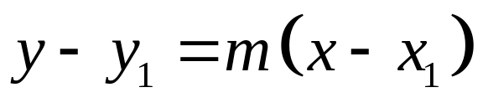
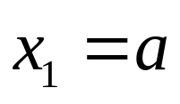
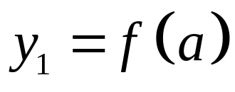
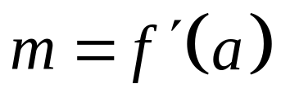
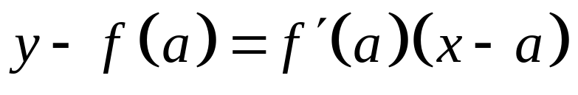
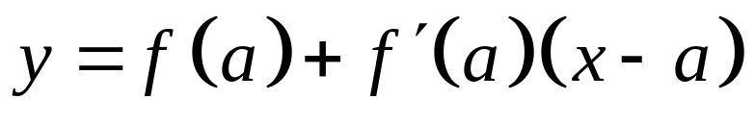
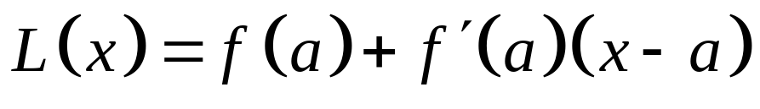
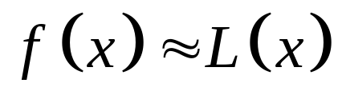
Start with the point/slope equation:
linearization of f at a
is the standard linear approximation of f at a.
The linearization is the equation of the tangent line, and you can use the old formulas if you like.

Slide 4
Using the linearization to approximate
a value on f(x)
Justifications for AP Test
If the graph is concave up the linearization/tangent line will give an underestimate of f(x)
If the graph is concave down the linearization/tangent will give an overestimate of f(x)

Slide 5
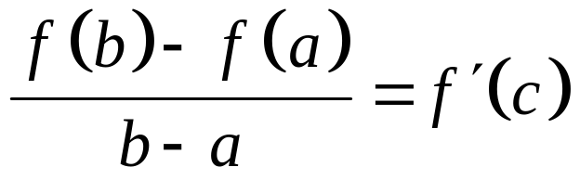
Mean Value Theorem for Derivatives
If f (x) is a differentiable function over [a,b], then at some point between a and b:

Slide 6
Mean Value Theorem for Derivatives
If f (x) is a differentiable function over [a,b], then at some point between a and b:
Differentiable implies that the function is also continuous.

Slide 7
Mean Value Theorem for Derivatives
If f (x) is a differentiable function over [a,b], then at some point between a and b:
Differentiable implies that the function is also continuous.
The Mean Value Theorem only applies over a closed interval.

Slide 8
Mean Value Theorem for Derivatives
If f (x) is a differentiable function over [a,b], then at some point between a and b:
The Mean Value Theorem says that at some point in the closed interval, the actual slope equals the average slope.

Slide 9
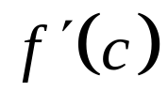

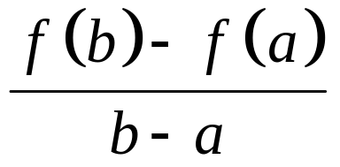




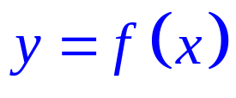
Tangent parallel to chord.
Slope of tangent:
Slope of chord:
Notes:
Go over example!

Slide 10
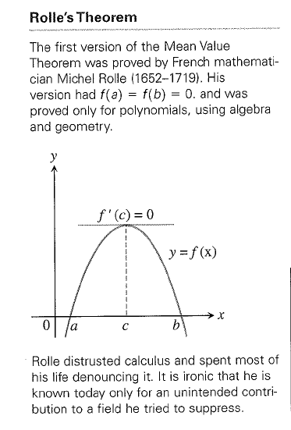
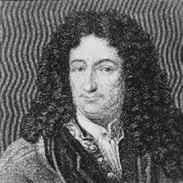
Michel Rolle (shown above)
French Mathematician
Published his version of the MVT in 1690 and proved it with algebra since he did not trust calculus.

Slide 11
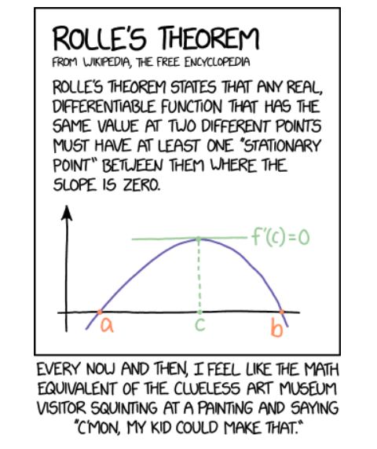

Slide 12
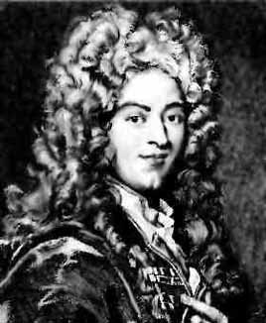
L’Hôpital’s Rule
Actually, L’Hôpital’s Rule was developed by his teacher Johann Bernoulli. De l’Hôpital paid Bernoulli for private lessons, and then published the first Calculus book based on those lessons.
Guillaume De l'Hôpital
1661 - 1704
Greg Kelly, Hanford High School, Richland, Washington

Slide 13
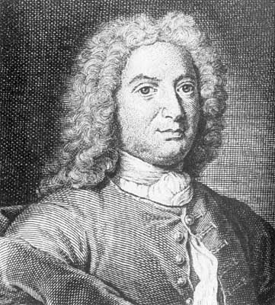
Johann Bernoulli
1667 - 1748

Slide 14
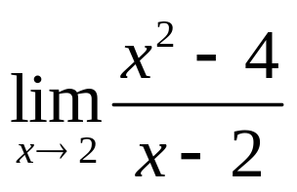

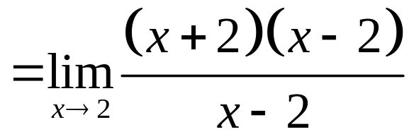
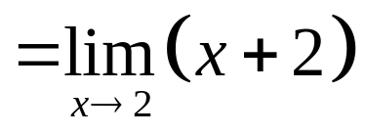

Consider:
If we try to evaluate this by direct substitution, we get:
Zero divided by zero can not be evaluated, and is an example of indeterminate form.
In this case, we can evaluate this limit by factoring and canceling:

Slide 15
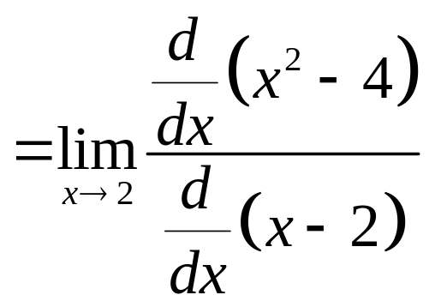
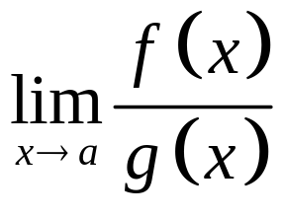
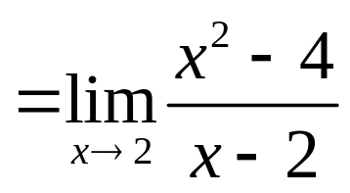
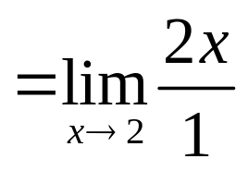
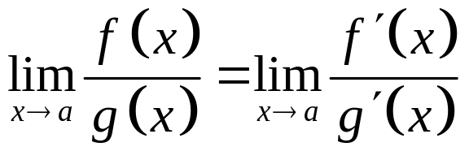
L’Hôpital’s Rule:
If is indeterminate, then:

Slide 16







L’Hôpital’s rule can be used to evaluate other indeterminate
forms besides .
The following are also considered indeterminate:
The first one, , can be evaluated just like .
The others must be changed to fractions first.

Slide 17


Slide 18
4.1,4.3, 4.5 HW
Linearization: Pg. 214: #57
(Estimate too big or too small without calculator)
MVT: Pg. 232: #3 and #5
L’Hopital’s: Pg. 246: #2, #11

Slide 19
L’Hopital Videos
L’hop and fractions:
https://www.youtube.com/watch?v=Sp0G-VggAoU&t=80s
L’hop and products:
https://www.youtube.com/watch?v=9DI4Rlzrae8

Slide 20
L’Hoptial Videos pt. 2
L’Hop and powers:
https://www.youtube.com/watch?v=6g_g9-AU188
L’Hop and differences:
https://www.youtube.com/watch?v=iKu4SGIeVjg&t=231s

